Slide 1
1.1 Displaying Distributions with Graphs AP Statistics

Slide 2
Categorical (Qualitative) Graphs
Pie Charts
Bar Graphs
Dotplots (unless categories are numerical)

Slide 3
Quantitative Graphs
Stem and Leaf Plots (Stem Plots)
Histograms

Slide 4
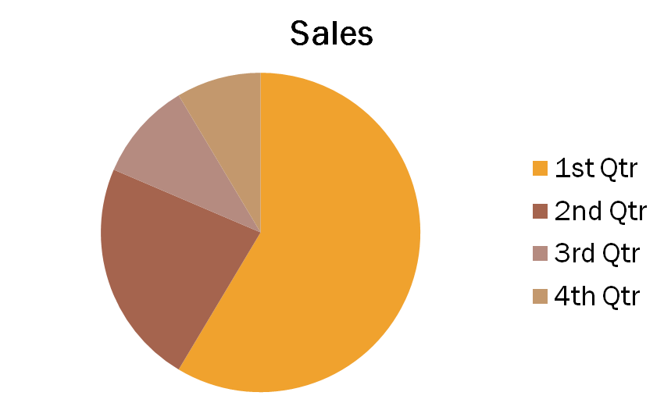
PIE Charts
Pie charts are awkward to make by hand
They must include all categories that make up the whole
Use only when you want to emphasize each category’s relationship to the whole

Slide 5
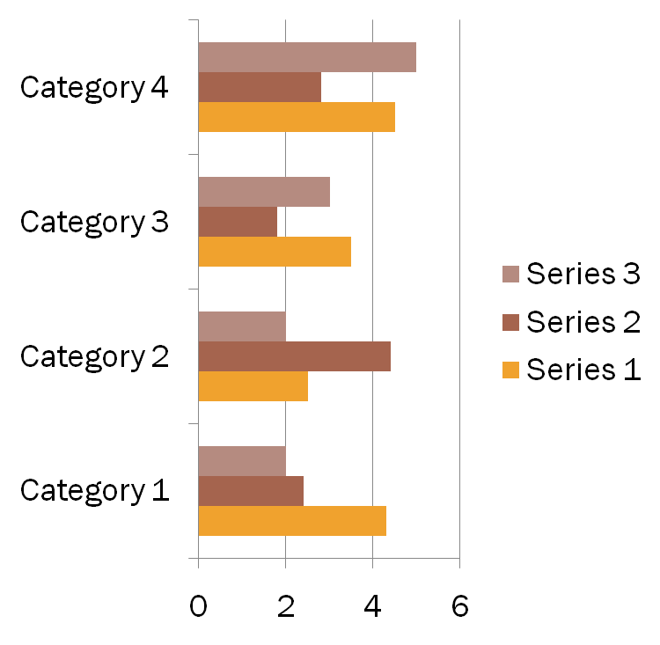
Bar Charts or Bar Graphs
Bar Graphs are easier to make and easier to read
Bar Graphs are more flexible than Pie Charts
Both graphs display the distribution of categorical variables
Both graphs help an audience to grasp data quickly

Slide 6
Making a Bar graph
Step 1: Draw a set of axes. Label your axes of the graph. Label your horizontal axis with your type that your categories fit in to. Title your graph.
Step 2: Scale your axes. Use the counts in each category to help you scale your vertical axis. Write the category names at equally spaced intervals beneath the horizontal axis.
Step 3: Draw a vertical bar above each category name to a height that corresponds to the count in each category.

Slide 7
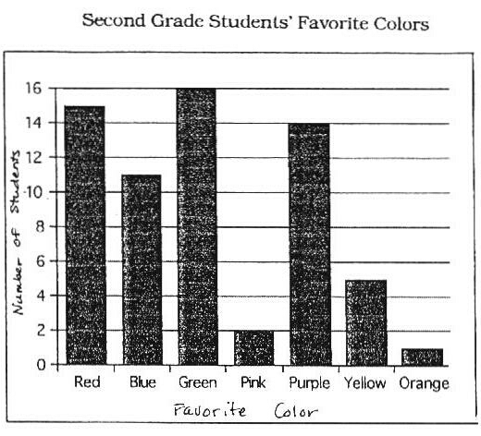

Slide 8
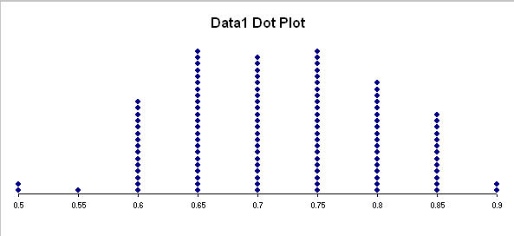
Dotplot
Dotplot - Is a statistical chart consisting of groups of data points plotted on a simple scale

Slide 9
Making a dotplot graph
Step 1: Draw a horizontal line and label it with the variable. Title your graph
Step 2: Scale the axis based on the values of the variable
Step 3: Mark a dot above the number on the horizontal axis corresponding to each data value.

Slide 10
Stem and leaf plots
Stemplot (Stem and Leaf) – Gives a quick picture of the shape of a distribution while including the actual numerical values in the graph.
Stemplot works best for small numbers of observations that are greater than zero.
They do not work well for large data sets where each stem must hold a large number of leaves

Slide 11
To make a stemplot
Separate each observation into a stem, consisting of all but the final (right-most) digit, and a leaf, the final digit.
Leaf always contains only one digit.
Write the stem in a vertical column with the smallest at the top, and draw a vertical line at the right of this column
Write each leaf in the row to the right of its stem, in increasing order out from the stem

Slide 12
Problem : Make a stem and leaf plot of the AP Statistics test scores given below. (no, these are not your scores from Ch. 5)
Test scores :56, 65, 98, 82, 64, 71, 78, 77, 86, 95, 91, 59,
69, 70, 80, 92, 76, 82, 85, 91, 92, 99, 73
Put in ascending order:
56, 59, 64, 65, 69, 70, 71, 73, 76, 77, 78, 80,
82, 82, 85, 86, 91, 91, 92, 92, 95, 98, 99
Place in stemplot:
Stem Leaf
5 6 9
6 4 5 9
7 0 1 3 6 7 8
8 0 2 2 5 6
9 1 1 2 2 5 8 9

Slide 13
Homework
Pg. 46 - 48 # 1.1(a & b), 1.4, 1.6(a & c)

